Slide 1
MVP – Project 3
Predicting high school students’ performance
Natália Bernardo

Slide 2
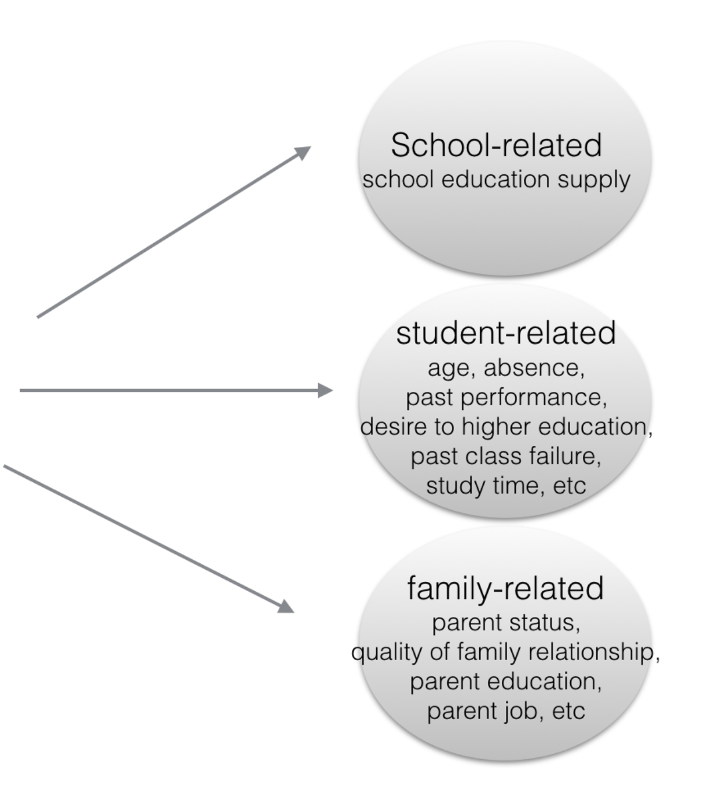
Predicting students’ performance based on lifestyle factors
Data: Student Performance Data Set based on two schools students information.
Source: UCI Machine Learning
649 observations
42 variables
Goal: Predict students who may fail to provide advanced help for them before the exam

Slide 3
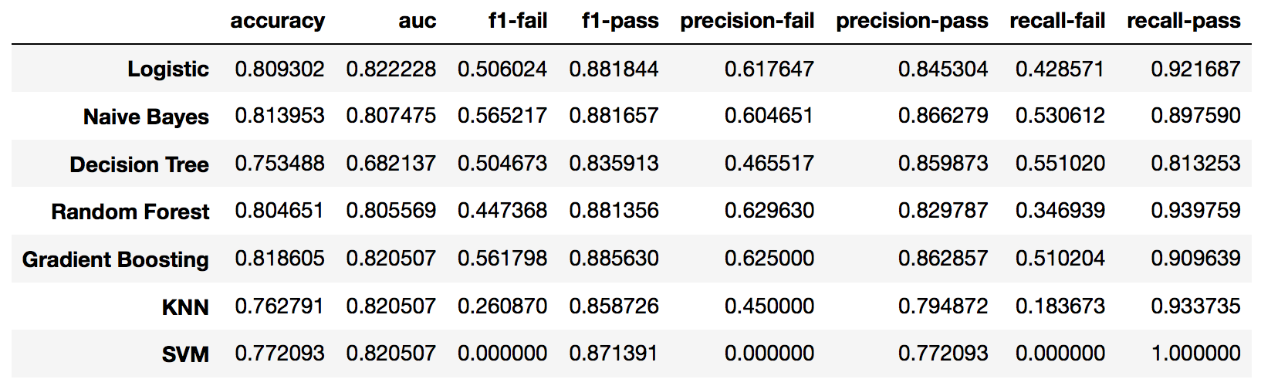
1st Stage: Select models to analyze
Objective:
Maximize recall for ‘fail’ & AUC
Notes:
Sometimes it is very important to limit either the Type I (false positive) or Type II (false negative) errors at the cost of the other.. I'd like to move the decision threshold to right to minimize the amount of false negatives, which would be especially important in cancer diagnoses.

Slide 4
1st Stage: Select models to analyze

Slide 5
2nd Stage: Models adjustments
Parameters tuning
Threshold to minimize false-negatives
Random Forest (gridsearchCV)
max_depth: 15,
n estimators: 18
Logistic Regression (CV)
cv= 10
C = 9.23
penalty = ‘l2’
Gradient Boosting (gridsearchCV)
learning_rate: 0.01
max_depth: 5
min_samples_split: 9
Naïve Bayes
“Pass”
(negative)
“Fail” (positive)
Threshold = 0.3
More students will be classified as “fail”

Slide 6
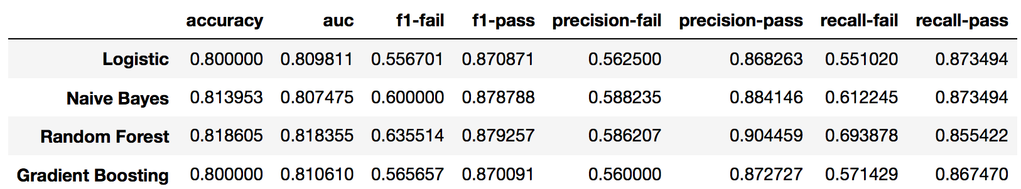
3st Stage: Select model

Slide 7
3st Stage: Select model
Predicted “Pass”
Predicted “Fail”
~70% of ”fail” students were detected
Actual “Pass”
TN = 142
FP = 24
Actual “fail”
FN = 15
TP = 34

